Slide 1
CO CSBG/Community Action
Regional Forums
2023
Community Needs Assessment, Action Planning, Performance Measurement & Management, and Publicizing Impact
Colorado Community
Action Association
Notes:
Alex

Slide 2
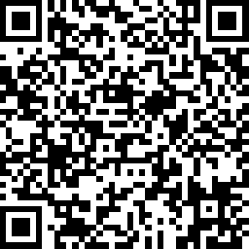
Sign-In Using Your Smartphone Camera
Colorado Community
Action Association

Slide 3
Land Acknowledgement
Every community owes its existence and vitality to generations from around the world who contributed their hopes, dreams, and energy to making the history that led to this moment.
Today's meeting is taking place on the traditional land of several indigenous groups to include the Sioux, Ute, Cheyenne, and Arapahoe peoples. Additionally, our reach extends throughout the state, covering the traditional land of various indigenous groups and cultures who have stewarded this land throughout generations and continue to do so. We acknowledge and express respect and gratitude to these people and are committed to continually working to create a long lasting, non -extractive, and supportive relationship with Native people throughout Colorado.
Colorado Community
Action Association
Notes:
Alex

Slide 4
Housekeeping
Parking lot questions
Restrooms
Breaks/Lunch
Purpose for today
Colorado Community
Action Association

Slide 5
Presenter Introductions
Alex Diaz, Colorado Department of Local Affairs
Colorado Community Action Association
Jessica Roschen
Liz Espinoza
Josiah Masingale
Colorado Community
Action Association

Slide 6
Icebreaker & Introductions
What condiment are you?
Name, pronouns, agency, title, what are you hoping to get out of today’s training?
For those involved with CSBG what are some challenges you face?
Are there local needs that you feel strongly about?
Colorado Community
Action Association

Slide 7
Agenda
Greetings & Introductions | 9:30 a.m.-9:50 a.m.
Community Needs Assessment & Action Planning | 9:50 a.m. – 11:30 a.m.
LUNCH | 11:30 am. – 12:30 p.m.
Performance Measurement & Management | 12:30 p.m. - 2:15 p.m.
Social Return on Investment/Local Theory of Change | 2:30 p.m. - 3:45 p.m.
Closing & Evaluations | 3:45 p.m. - 4:00 p.m.
ROMA NCRT Review Office Hours (special sign-up required) | 4:00 pm. - 5:00 p.m.
Colorado Community
Action Association
Notes:
Going to take a look at how community action came to be and how we got where we are today.
Look again at the ROMA model and how the tripartite board is involved in the process and use information from the Community Needs Assessment to drive the entire proves.

Slide 8
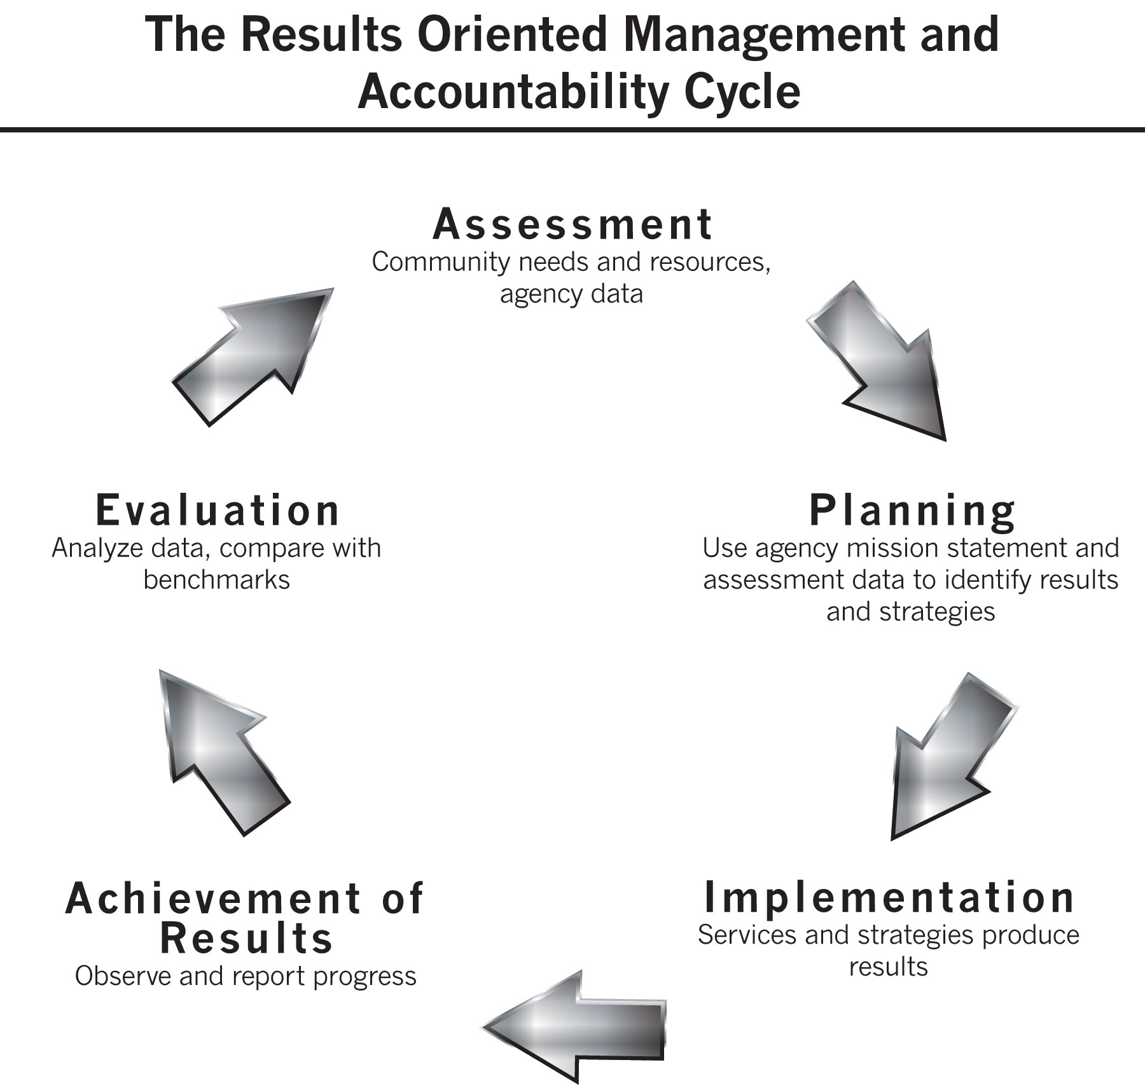
Focus on assessing needs and resources of customers; demographic profiles considered in contextualizing the needs
Documentation of systematic internal review of data as well as external reporting.
Documentation of use of plan to assess success (improved targeting)
Reports document changes at family, agency and community levels. Were needs met?
Tracking of progress and success and how these relate to the services provided
Staff using ROMA principles in direct service to help seekers
Colorado Community
Action Association
Notes:
Demographic profile provides the contextualization that we will need to become better at projecting outcomes. And which services helped them achieve that outcome, ultimately determining our impact.
More thoughtful, interlocking way of looking at the cycle. Using results to determine future plans.
Again, the tripartite board should be involved in this process.

Slide 9
What is Results-Oriented Management & Accountability (ROMA)?
ROMA is a full management and accountability system designed to help Community Action Agencies improve their ability to achieve results.
We can think of the ROMA system as being about looking at the CAA/CSBG network from three views:
What is happening in the agency?
Mission, plan, services, reports accurate and timely?
Managing its money well?
What kinds of outcomes are being reported? Observed? Documented?
What has changed? What is better?
How is the community involved?
Colorado Community
Action Association
Notes:
What is the mission, what is the plan to achieve the mission, what are the services that will help you achieve your mission?
What is going on an agency, what outcomes are being reported and how is the community involved in the process? This process will be covered in the logic model.

Slide 10
Engage tribes, tribal organizations, and indigenous populations locally
Colorado Community
Action Association

Slide 11
Colorado Community
Action Association

Slide 12
ACTIVITY
Large Group Brainstorm:
Who are our Customers?
Colorado Community
Action Association
Colorado Community
Action Association
Notes:
Define Parameters of the Assessment- Define the Community, its needs, and its assets. Do we look at those around service categories (housing, transportation, etc) or by population in the community, or otherwise? What does this look like in your agency? How do you define your community?
Create an Assessment Plan- Create an Assessment Team, an assessment coordinator, an agency team to brainstorm around needs, assets, and a wish list for data collection. The agency team can include tripartite board members or community members. Can be a small team.
Create a Data Collection Plan- decide what data you will collect and how, survey, interviews, focus groups, forums. What do you need to report to your funders? In what database? How to organize & present to the public? We will talk more about more in depth soon.
Implement the Needs Assessment Survey- create a timeline & assign responsibility, establish a budget, define staff roles, recruit partners and finalize data collection plan, collect the data
Report and Take Action- Analyze and report the data, create the community profile, organize non quantitative data

Slide 13
Things to Consider Prior to the Community Needs Assessment
What was done in the past?
Past Needs Assessment review
Past plans review
Current agency customer data review
Customer/stakeholder input and feedback review
Colorado Community
Action Association
Notes:
Define Parameters of the Assessment- Define the Community, its needs, and its assets. Do we look at those around service categories (housing, transportation, etc) or by population in the community, or otherwise? What does this look like in your agency? How do you define your community?
Create an Assessment Plan- Create an Assessment Team, an assessment coordinator, an agency team to brainstorm around needs, assets, and a wish list for data collection. The agency team can include tripartite board members or community members. Can be a small team.
Create a Data Collection Plan- decide what data you will collect and how, survey, interviews, focus groups, forums. What do you need to report to your funders? In what database? How to organize & present to the public? We will talk more about more in depth soon.
Implement the Needs Assessment Survey- create a timeline & assign responsibility, establish a budget, define staff roles, recruit partners and finalize data collection plan, collect the data
Report and Take Action- Analyze and report the data, create the community profile, organize non quantitative data

Slide 14
ACTIVITY
Pairs/Small Group Handout:
What were the major findings of the previous three-year Community Needs Assessment?
Who received services or benefited from the community strategies implemented?
Were any changes made to the strategies/services during the current three-year period?
What progress has been made towards the previous three-year Community Action Plan goals?
Is there a Theory of Change model in place for those with low-incomes and/or low-income neighborhoods?
Are there any environmental scan items (external trends/unique opportunities) that need to be considered during the upcoming Community Needs Assessment?
Large group report out/discussion
Colorado Community
Action Association
Colorado Community
Action Association
Notes:
Define Parameters of the Assessment- Define the Community, its needs, and its assets. Do we look at those around service categories (housing, transportation, etc) or by population in the community, or otherwise? What does this look like in your agency? How do you define your community?
Create an Assessment Plan- Create an Assessment Team, an assessment coordinator, an agency team to brainstorm around needs, assets, and a wish list for data collection. The agency team can include tripartite board members or community members. Can be a small team.
Create a Data Collection Plan- decide what data you will collect and how, survey, interviews, focus groups, forums. What do you need to report to your funders? In what database? How to organize & present to the public? We will talk more about more in depth soon.
Implement the Needs Assessment Survey- create a timeline & assign responsibility, establish a budget, define staff roles, recruit partners and finalize data collection plan, collect the data
Report and Take Action- Analyze and report the data, create the community profile, organize non quantitative data

Slide 15
Data: Qualitative
It is important to survey primary customers (those that receive the services) and secondary customers (community, partner agencies, funders) to provide local perspective and context to the needs of the community.
Qualitative Data Examples:
Customer Satisfaction Survey(s): Org Standard 1.3 and 6.4 – Gauge the overall satisfaction of the customer with their interaction with the program/agency.
Customer Satisfaction Survey Template
Agency/Community Surveys: Org Standard 1.2 – Information collected directly from low-income individuals and/or community members.
SAMPLE Community Needs Assessment Survey
Key Informant Surveys: Group prioritization exercise for customers/board
Focus groups, forums and/or interviews: individual/group; varied formats
Colorado Community
Action Association
Notes:
SLIDE MANAGEMENT: PRESENTATION SLIDE
SLIDE MANAGEMENT: CUSTOMER SATISFACTION SURVEY
Best done electronically/ accessible. How dist and returned drives how easy to analyze / aggregate
SLIDE MANAGEMENT: COMMUNITY NEEDS ASSESSMENT SURVEY
Electronically is best.
Ag/ Comm: For anybody in the comm’y, used for key stakeholders, current pot cust, tp adv members, (1st q types of people)
Specifric area: ex private business. Geared toward specificaudience.

Slide 16
Data: Quantitative
As part of the community assessment, the organization collects and includes current data specific to poverty and its prevalence related to gender, age, and race/ethnicity for their service area (Org Standard 3.2)
Quantitative Data: Demographic/social/economic to contextualize needs
Community Action Partnership’s National Data Hub: https://cap.engagementnetwork.org/
Colorado Demography Office: https://demography.dola.colorado.gov/
DOLA/Demography CSBG Data Hub
Census, American Community Survey
Internal database(s), partner databases, shared community database(s)
Colorado Community
Action Association
Notes:
SLIDE MANAGEMENT: PRESENTATION SLIDE
Natl Data Hub overview.
Show the table that gives poverty and its prevalence with age, gender, race, and ethnicity.
EXAMPLE Baca County and identify some key data elements.
DOLA Demographers Office and CSBG Data set overview.
EXAMPLE Baca County and identify some key data elements.
Quickly note the Census and ACS websites and some data that can be obtained such as Grandparent data.
Don’t forget about your own internal data, your partner agency data that might be shareable, and any relevant community databases that might be available locally to access for valuable quantitative and qualitative data.

Slide 17
Data: Other Key Sectors
The organization utilizes information gathered from key sectors of the community in assessing needs and resources, during the community assessment process or other times. These sectors would include at minimum: community-based organizations, faith-based organizations, private sector, public sector, and educational institutions. (Org Standard 2.2)
Examples:
Community-Based Organizations: Partner customer data; Case Manager interview(s)
Faith-Based Organizations: Customer needs survey; resource mapping exercise
Private Sector: Major industry worker retention analysis; economic development focus group
Education Institutions: Free and Reduced Lunch Data; Student Resource Officer Survey
Public and Other Sources:
Housing studies/plans/assessments (E.g.Denver Housing Stability 2021 Action Plan)
Transportation studies/plans/assessments (E.g. NWCCOG's Transportation Gap Analysis Assessment 2021)
Public health studies/plans/assessments (E.g. Southwest Health System’s Community Health Needs Assessment and Implementation Plan October 2022)
Broadband studies/plans (E.g. NWCCOG’s Regional Broadband Ten Year Report 2022)
Area Agency on Aging studies/plans (E.g. Boulder County’s Age Well Boulder County Action Plan)
Early Childhood studies/plans (E.g. NWCCOG’s Regional Assessment of Child Care Industry 2021)
Colorado Community
Action Association
Notes:
SLIDE MANAGEMENT: PRESENTATION SLIDE
Include info from these sectors specifically as laid out in OS.
ec’ dev : business owners, downtown,
Education: Survey sro’s
Links not on CCAA page bc examples from specific communities, sothose not in denver won’t want to use denver for their housing study.
All post 2020. Post COVID for relevancy. RECENT.
OUTSIDE org
Multiple resources from source

Slide 18
Data: Other Key Sectors
The organization utilizes information gathered from key sectors of the community in assessing needs and resources, during the community assessment process or other times. These sectors would include at minimum: community-based organizations, faith-based organizations, private sector, public sector, and educational institutions. (Org Standard 2.2)
State Departmental and Other Data:
Housing - Colorado Division of Housing Data
Public Health and Environment - CDPHE Data
Department of Health Care Policy and Financing - HCPF Publications
Education - CDE Data
Human Services - CDHS Data
Transportation - CDOT Library
Workforce - Colorado Talent Dashboard
Youth
Colorado Department of Early Childhood Reports and Data
Colorado Children’s Campaigns Kids Count in Colorado 2022
Broadband - Colorado Broadband Office’s Data and Mapping Hub
Colorado Community
Action Association
Notes:
SLIDE MANAGEMENT: PRESENTATION SLIDE
State Departments are excellent source of quantitative and qualitative data that may be considered and analyzed.
EXAMPLE Licensed Child Care Facilities Report Data Baca County
EXAMPLE Kids Count Data Baca County
Don’t need to consider/include all of this…these are ideas of where to go to find data.

Slide 19
Data: Other Key Sectors
The organization utilizes information gathered from key sectors of the community in assessing needs and resources, during the community assessment process or other times. These sectors would include at minimum: community-based organizations, faith-based organizations, private sector, public sector, and educational institutions. (Org Standard 2.2)
Studies, Plans, and Standards:
Energy - Colorado Energy Office’s Pathway to Energy Affordability in Colorado - January 2022
Self-Sufficiency Standard - Colorado Center for Law and Policy Self-Sufficiency Standard for Colorado 2022
Living Wages - MIT Living Wage Calculator
Homelessness - MDHI’s State of Homelessness Report 2022-2023
Health - Colorado Health Institute’s Colorado Health Access Survey 2021
Education - Colorado Department of Education Strategic Plan Updated 2023
Broadband - Colorado Broadband Roadmap
Colorado Community
Action Association
Notes:
SLIDE MANAGEMENT: PRESENTATION SLIDE
Don’t need all.
SLIDE MANAGEMENT: SELF-SUFFICIENCY STANDARD EXAMPLE
SLIDE MANAGEMENT: LIVING WAGE CALCULATOR EXAMPLE

Slide 20
ACTIVITY
Large Group Discussion:
What are data resources you know you will need to consider?
Colorado Community
Action Association
Colorado Community
Action Association
Notes:
Define Parameters of the Assessment- Define the Community, its needs, and its assets. Do we look at those around service categories (housing, transportation, etc) or by population in the community, or otherwise? What does this look like in your agency? How do you define your community?
Create an Assessment Plan- Create an Assessment Team, an assessment coordinator, an agency team to brainstorm around needs, assets, and a wish list for data collection. The agency team can include tripartite board members or community members. Can be a small team.
Create a Data Collection Plan- decide what data you will collect and how, survey, interviews, focus groups, forums. What do you need to report to your funders? In what database? How to organize & present to the public? We will talk more about more in depth soon.
Implement the Needs Assessment Survey- create a timeline & assign responsibility, establish a budget, define staff roles, recruit partners and finalize data collection plan, collect the data
Report and Take Action- Analyze and report the data, create the community profile, organize non quantitative data

Slide 21
Identification of Asset Groups
Developmental Assets allow residents to attain the skills needed to be successful in all aspects of daily life (e.g., educational institutions, early learning centers, and health resources).
Commercial Assets are associated with production, employment, transactions, and sales (e.g., labor force and retail establishments).
Recreational assets which create value in a neighborhood beyond work and education (e.g., parks, open space, community gardens, and arts organizations).
Physical assets associated with the built environment and physical infrastructure (e.g., housing, commercial buildings, and roads).
Social assets establish well-functioning social interactions (e.g., public safety and community services).
Colorado Community
Action Association
Notes:
What types of assets are there.

Slide 22
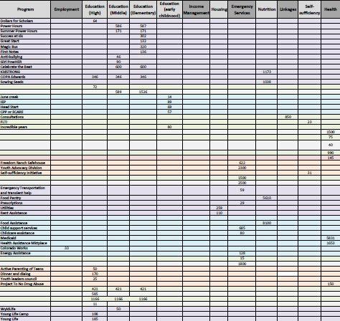
What are our Community Resources?
Gaps
Agencies w/similar missions as Opp
Threatened resources opportunity
Theory of Change
Resources/Asset Mapping Example
Resources Asset Mapping Template
Colorado Center for Law and Policy’s Human Services Gap Map
Colorado Community
Action Association
Notes:
SLIDE MANAGEMENT: PRESENTATION SLIDE
The federal CSBG Act also requires eligible entities to assess the resources both available and lacking in the area served.
Are there any gaps in resources in the community?
Are there other agencies/programs with a similar approach? With similar missions?
Are there any resources that are threatened? What resources are plentiful and widespread?
Are there any local Theory of Change approaches that have a collective approach to poverty in the area served?
SLIDE MANAGEMENT: EAGLE COUNTY ASSET MAPPING
Here is a great example of a Resource/Asset Map created by Eagle County that notes the number of resources in different domains and the agencies that have those resources. This can help identify strengths and gaps in the resources available locally.
Highlight CCLP Human Services Gap Map Baca County Example

Slide 23
ACTIVITY
Large Group Discussion:
What are community resources you know you will need to consider?
Colorado Community
Action Association
Colorado Community
Action Association
Notes:
Define Parameters of the Assessment- Define the Community, its needs, and its assets. Do we look at those around service categories (housing, transportation, etc) or by population in the community, or otherwise? What does this look like in your agency? How do you define your community?
Create an Assessment Plan- Create an Assessment Team, an assessment coordinator, an agency team to brainstorm around needs, assets, and a wish list for data collection. The agency team can include tripartite board members or community members. Can be a small team.
Create a Data Collection Plan- decide what data you will collect and how, survey, interviews, focus groups, forums. What do you need to report to your funders? In what database? How to organize & present to the public? We will talk more about more in depth soon.
Implement the Needs Assessment Survey- create a timeline & assign responsibility, establish a budget, define staff roles, recruit partners and finalize data collection plan, collect the data
Report and Take Action- Analyze and report the data, create the community profile, organize non quantitative data

Slide 24
Simple Analysis Techniques
Aggregate
Count
Compare
Identify trends
MATERIAL FROM INTRO TO ROMA 5.1, 2020 AND 2011 ROMA Trainer MANUAL
Colorado Community
Action Association
Notes:
Some say “we count up the surveys” -- ok but then what?
That is the aggregation part but just counting them up doesn’t tell you what is priority.
Analysis of data can be complex and can require specific skills and training to do properly.
However, this page provides examples of four basic techniques that can be done with minimum difficulty
and should be within the skill level of typical CAA staff.
We consider the Type of data and HOW we will aggregate it.
First we Count,
How many live in a certain area, how many of a certain characteristic such as age, income ect…?
What is the status of housing, employment, ect
How many units or jobs are available?
Once we have counted, now we have to Compare:
Some questions you can ask to “compare”
Where do you see the largest numbers? Are responses bigger than last year? Did the resources change? Do you see a change in demographics of participants?
This can lead to the identification of trends that could help to prioritize something that is getting to be a larger need,
or to reduce the priority of something that seems to be a smaller need.
An example is resources or neighborhoods change.

Slide 25
Analyzing the Assessment Data to Identify Priorities
Facts
Figures
Stories
There are numerous methods to help you identify the issues in your community that have risen to the top of the list and ways to help decide which issues the agency will address.
A few of these are:
■ Identify root causes/The Five Why’s
■ Force Field Analysis
■ Comparison techniques
■ Cause and effect
■ Trend analysis
Raw data is not information! It must be analyzed before it becomes useful!
MATERIAL FROM INTRO TO ROMA 5.1, 2020 AND 2011 ROMA Trainer MANUAL
Colorado Community
Action Association
Notes:
PM 49 TM 56-57 K80-81
We are now on page 49 PM Analyzing the Assessment Data.
This is a very important area of the assessment process.
Often agencies that conduct very thorough assessments, including the full range of customers (both primary and supporting), end up with too much data.
Raw data is not useful information. It has to be analyzed before it can be useful.
Once you have gathered all of this data about the community needs and resources, what do you do with it?
Before you begin to make your agency plan, you must find a way to organize the information you have collected and make some “sense” of it.
How does your agency analyze the data from your assessment activities to help you move towards formulating a plan?
Let’s look at some questions that could help your agency organize the information at the bottom of page 49
What are some of the root causes of the problem?
Why should we be interested in the problem?
What can be done to address the issue?
WHO should address the issue?
Do we have control, or partial control over the issue?
Do we have capabilities to address the issue?
What programs can address the issue?
What might we change in our agency to help address the issue?
Can we partner with someone to help address the issue?

Slide 26
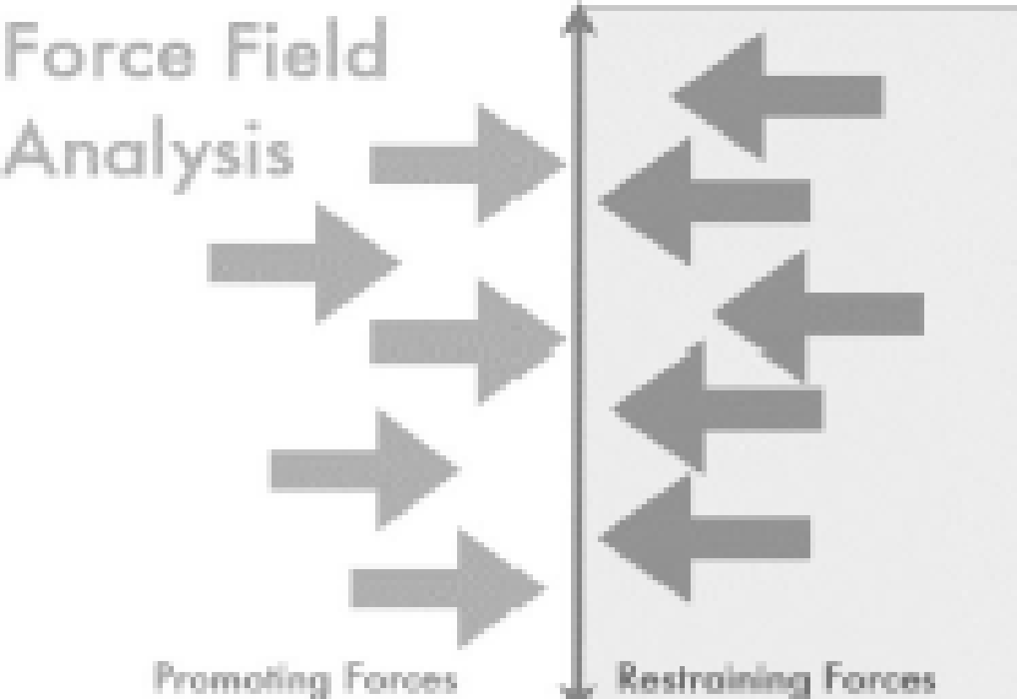
Force Field Analysis Example Affordable Housing
Increased Local, State, Fed Funding
NIMBY
Increased Public Awareness and Agreement
Cost of Land & Construction
Strong Community Collaborations
Exponential Increase in Demand/Lack of Affordable Builds
PM page 51
MATERIAL FROM INTRO TO ROMA 5.1, 2020
Colorado Community
Action Association
Notes:
PM 51 TM56-57 K84
Page 51-PM Identifying Agency Priorities
This page opens with two things every agency must consider: Mission and Resources.
Not every identified need will become a top priority for your agency.
Let’s say “improvement of public schools” has risen to the top priority using a number of different data sources and analysis techniques.
Is this something that the CAA has in its mission? It may be a part of other elements of mission, but it probably isn’t something the agency wants to put the majority of its efforts into.
– We also need to think about what kind of resources would be needed to address this need?
The agency could consider what resources it has or that it could develop to address the need –
Just because this has been identified as the top community level need,
does NOT mean that it must be the top need of the local CAA.
Additional techniques mentioned to help with prioritization:
Root cause/5 whys
Force field analysis which is a basic tool for root cause analysis.
Cause and effect

Slide 27
1. Assume and bring good intentions
2. Listen with curiosity for new understanding
3. Expect and accept lack of closure
4. Make space for mistakes
5. Acknowledge trauma and resist re-traumatization
Guiding Principles
Colorado Community
Action Association

Slide 28
Causes and Conditions of Poverty Definitions
Causes of poverty are negative factors that create or foster barriers to self-sufficiency and/or reduces access to resources in communities in which individuals with low-income reside.
Conditions of poverty are negative environmental, safety, health, social and/or economic conditions that may reduce investment or growth in communities where individuals with low-income reside.
Colorado Community
Action Association
Notes:
Assessment (Point-In-Time Evaluations of Family/Community Well-Being) data is often overlooked -- CAA staff “knows” what the community needs are – they are the same from year to year, or are obvious (most important is lack of jobs or lack of people who are employed – regardless of the community).
But if we don’t drill down to the “why” behind the issue. For example, just knowing the community needs more people employed isn’t helpful. We need to use assessment data to help us think about the problem in new ways.
Seeing a clients full picture, beyond one point in time helps us to see more of the “why’s” behind clients’ needs. One need could be driving customers to consume multiple services. No job > no food> go to pantry.
Must collect more data for longer to know the true impact of our services, then link back to demographics, effectiveness of services, etc.

Slide 29
Causes of Poverty in Colorado
Of the many causes of poverty in CO, the most common include:
Low wages/Underemployment: The minimum wage in Colorado is $13.65 per hour, which is not enough to support a family of four above the poverty line. Additionally, many individuals must work more than 1 job.
Unemployment: The unemployment rate in Colorado is 2.9%, which is relatively low, but there are still many people who are out of work.
Lack of affordable housing: The cost of housing in Colorado is rising rapidly, making it difficult for people to find affordable places to live.
Education: Poor/ insufficient education can make it difficult to find a good-paying job.
Healthcare: The cost of healthcare can be a major financial burden for families, especially those who are uninsured or underinsured.
Discrimination: People of color and people with disabilities are more likely to live in poverty than white people and people without disabilities.
There are many other factors that can contribute to poverty (be causes and conditions of poverty), such as lack of access to childcare, transportation, and other resources.
Colorado Community
Action Association

Slide 30
Conditions of Poverty in Colorado
Poverty has a significant impact on people's lives, & there are many common conditions that people living in poverty in Colorado may experience including:
Food insecurity: People living in poverty may not have enough money to buy food or may have to choose between buying food & other necessities, such as housing or healthcare.
Lack of affordable housing: The cost of housing in Colorado is rising, making it difficult for people to find affordable places to live. This can lead to homelessness or overcrowding.
Health problems: People living in poverty are more likely to have health problems such as obesity, diabetes, and heart disease. Causal factors include lack of access to healthcare, poor diet, and stress.
Poor education: Children living in poverty are more likely to drop out of school and have lower educational attainment than children from middle-income or wealthy families. This limits future job opportunities and earning potential.
Violence: People living in poverty are more likely to be victims of violence, such as crime, domestic violence, and child abuse. Causal factors include poverty-related stress & lack of resources.
Poverty can have a significant impact on people's lives, and it is important to address the causes of poverty in order to improve the lives of people who are struggling.
Colorado Community
Action Association

Slide 31
ACTIVITY
Pairs/Small Group:
What are local Causes of Poverty?
What are local Conditions of Poverty?
Large Group report out/discussion
Colorado Community
Action Association
Colorado Community
Action Association
Notes:
Define Parameters of the Assessment- Define the Community, its needs, and its assets. Do we look at those around service categories (housing, transportation, etc) or by population in the community, or otherwise? What does this look like in your agency? How do you define your community?
Create an Assessment Plan- Create an Assessment Team, an assessment coordinator, an agency team to brainstorm around needs, assets, and a wish list for data collection. The agency team can include tripartite board members or community members. Can be a small team.
Create a Data Collection Plan- decide what data you will collect and how, survey, interviews, focus groups, forums. What do you need to report to your funders? In what database? How to organize & present to the public? We will talk more about more in depth soon.
Implement the Needs Assessment Survey- create a timeline & assign responsibility, establish a budget, define staff roles, recruit partners and finalize data collection plan, collect the data
Report and Take Action- Analyze and report the data, create the community profile, organize non quantitative data

Slide 32
What are our Needs?
ACTIVITY
Individually
Identify three issues facing your community.
Be sure you can identify as family, agency or community level.
Be sure to follow the rules!
You cannot use one word.
Do not identify the service that you feel would address the need, but rather must consider the need that itself.
Do not say “It’s all three levels.”
MATERIAL FROM INTRO TO ROMA 5.1, 2020
Colorado Community
Action Association
Notes:
PM 48 TM 52-56 K77-79
Please turn to Page 48-PM.
Ask participants to work independently first.
Have participants write their top three needs, being sure to follow instructions on page 48.
IDENTIFY (DESCRIBE) THE SITUATION AS IT IS PRIOR TO ANY SERVICE OR STRATEGY.

Slide 33
ACTIVITY
Large Group:
Key Informant Survey
Colorado Community
Action Association
Colorado Community
Action Association

Slide 34
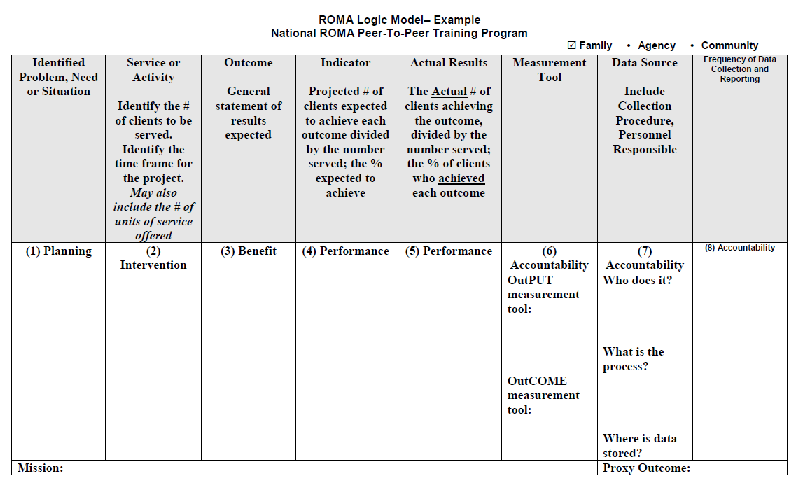
Logic Model Introduction
MATERIAL FROM INTRO TO ROMA 5.1 2020
Colorado Community
Action Association
Colorado Community
Action Association

Slide 35
Needs Assessment to Action Planning
What other funds/resources will/can be leveraged?
Internal activities versus sub-awarding
Referencing relevant Strategic Plans
Board and Key Stakeholders Input/Acceptance
Activity
Colorado Community
Action Association
Notes:
Assessment (Point-In-Time Evaluations of Family/Community Well-Being) data is often overlooked -- CAA staff “knows” what the community needs are – they are the same from year to year, or are obvious (most important is lack of jobs or lack of people who are employed – regardless of the community).
But if we don’t drill down to the “why” behind the issue. For example, just knowing the community needs more people employed isn’t helpful. We need to use assessment data to help us think about the problem in new ways.
Seeing a clients full picture, beyond one point in time helps us to see more of the “why’s” behind clients’ needs. One need could be driving customers to consume multiple services. No job > no food> go to pantry.
Must collect more data for longer to know the true impact of our services, then link back to demographics, effectiveness of services, etc.

Slide 36
ACTIVITY
Large Group Discussion:
Key takeaways from handout of the application sections on the Community Action Plan & Strategic Plan
Colorado Community
Action Association
Colorado Community
Action Association

Slide 37
ACTIVITY
What are our Outcomes?
Individuals need transportation to get to work.
Staff lack skills to work with families in trauma.
There is not enough affordable housing in our community.
Families need housing they can afford.
We do not have a housing program at our agency.
Individuals need skills to prepare them for living wage jobs.
Children are not ready for school.
Senior citizens’ homes are in disrepair which threatens independence.
Families report food scarcity at least once a month.
There are no summer feeding programs in our community.
Individuals acquire transportation.
Staff have skills to work with families in trauma.
The community increases its affordable housing units.
Families secure affordable housing.
We do have a housing program at our agency.
Individuals have skills for living wage jobs.
Children are ready for school.
Senior citizen homes are in good repair.
Families report food scarcity less than once a month.
The community has summer feeding programs.
Activity
MATERIAL FROM INTRO TO ROMA 5.1, 2020
PM page 73
Colorado Community
Action Association
Notes:
PM 73 TM 72-73 K115
| Activity – What Is the Outcome? (TM 72-73)
Start with just the title. Explain the activity is going to be creating an outcome statement that matches a need statement that will be provided.
Present the first need and ask what level it is. Then show (teach) the corresponding outcome, also on the same level.
Do the first two examples and then have participants do the rest.
Do this activity with the group because it is a quick activity – participants can chat or speak up.
NEED–OUTCOME
1 Individuals need transportation to get to work. (F)
Individuals have transportation.
NOT: individuals get jobs
And NOT: individuals receive transportation service
2 Staff lacks skills to work with families in trauma. (A)
Staff has skills.
3 There is not enough affordable housing in our community. (C)
The community increases its affordable housing units.
4 Families need housing they can afford. (F)
Families reside in affordable housing.
5 We do not have a housing program at our agency. (A)
We have a housing program at our agency.
6 Individuals need skills to prepare them for living wage jobs. (F)
Individuals acquire skills.
Not: individuals get jobs
7 Children are not ready for school. (F)
Children are ready for school.
8 Senior citizens’ homes are in disrepair which threatens independence. (F)
Senior citizens homes are in good repair.
Not they get housing repairs, as that is the service. Not: they remain independent (as there could be other issues too)
9 Families report food scarcity at least once a month. (F)
This could be stated as: families report they experience hunger at least once a month.
Families report decrease in food scarcity.
Or Families report food scarcity less than once a month.
Or Families report no hunger has been experienced in the past six months.
10 There are no summer feeding programs in this community. (C)
The community has summer feeding program.

Slide 38
ACTIVITY
Large Group Discussion:
What are our outcomes?
Colorado Community
Action Association
Colorado Community
Action Association

Slide 39
What are the Services/Strategies in Relation to our Outcomes?
F/A/C Level Connected to Needs/Outcomes
I NEED A VACATION example
Stability versus Economic Security Services (Provision of Services vs Strategic Thinking models)
Activity
Colorado Community
Action Association
Notes:
Assessment (Point-In-Time Evaluations of Family/Community Well-Being) data is often overlooked -- CAA staff “knows” what the community needs are – they are the same from year to year, or are obvious (most important is lack of jobs or lack of people who are employed – regardless of the community).
But if we don’t drill down to the “why” behind the issue. For example, just knowing the community needs more people employed isn’t helpful. We need to use assessment data to help us think about the problem in new ways.
Seeing a clients full picture, beyond one point in time helps us to see more of the “why’s” behind clients’ needs. One need could be driving customers to consume multiple services. No job > no food> go to pantry.
Must collect more data for longer to know the true impact of our services, then link back to demographics, effectiveness of services, etc.

Slide 40
What are the Services/Strategies in Relation to our Outcomes?
Activity
Provision of Services and Strategic Thinking
Pros and Cons of Both Models
Model:
Provision of Services
Strategic Thinking
PROS
CONS
Doesn’t produce long term change
Limited impact in complex situations
Putting resources in these services means not having resources for other services
Serve a large number of people
Meet an immediate need
Can prevent a crisis
Put services together into a bundle to address complex situations
Involves community engagement to address larger problems
Creates partnerships to meet needs agency cannot meet alone
Need focused resources; has higher cost
Serve fewer people
Takes a long time to see outcomes
Must plan for coordination
May require training for staff
Colorado Community
Action Association
Notes:
Assessment (Point-In-Time Evaluations of Family/Community Well-Being) data is often overlooked -- CAA staff “knows” what the community needs are – they are the same from year to year, or are obvious (most important is lack of jobs or lack of people who are employed – regardless of the community).
But if we don’t drill down to the “why” behind the issue. For example, just knowing the community needs more people employed isn’t helpful. We need to use assessment data to help us think about the problem in new ways.
Seeing a clients full picture, beyond one point in time helps us to see more of the “why’s” behind clients’ needs. One need could be driving customers to consume multiple services. No job > no food> go to pantry.
Must collect more data for longer to know the true impact of our services, then link back to demographics, effectiveness of services, etc.

Slide 41
Outcomes and Outputs
Output = service; doing something; the process of assistance
Outcome = change;
accomplishing something
Activity
PM page 81
MATERIAL FROM INTRO TO ROMA 5.1, 2020
Colorado Community
Action Association
Notes:
PM 81 TM 80 K125-125
OutPut – P for Process
OutCome – C for Change
point out the key elements of the examples on PM page 81 K125-126 – Difference between “participates” and “increases skills” ; “receives assistance” and “avoid shut off”
Remember, the outcome is the change that happens to the customer as a result of the service. If you cannot say that something has changed, then the item is likely an output, not an outcome.

Slide 42
After School Program:
_____ Children master new activities.
_____ 15 at-risk children attend after school sessions _____ Activities are designed to encourage cooperative play.
_____ Children’s social skills improve.
_____ Children make more positive use of free time outside the program.
OC
OP
OP
OC
OC
Activity
Parent Education Program:
_____ Parents from 10 families attend workshops
_____ Six group workshops are conducted.
_____ Parents’ understanding of children’s developmental issues increases.
_____ Parents provide more age-appropriate guidance to children.
_____ Parents participate in role plays and group discussion
OP
Activity: Outcomes and Outputs
OP
OC
OC
OP
Tutoring Program:
_____ 20 children in grades 4 to 8 are matched with high school tutors.
_____ Children’s academic performance increases.
_____ Children indicate increased belief in their abilities to learn new subjects.
_____ Children receive one-to-one help in reading and math.
_____ Tutors emphasize the importance of education.
OP
OC
OC
OP
OP
MATERIAL FROM INTRO TO ROMA 5.1, 2020
Colorado Community
Action Association
Notes:
PM-82 TM 81-82 K127
Teach the first example-Adult Basic Education.
Cover another (Employment or Emergency Assistance) by getting input from participants.
Then break the participants into groups. Directions are in the Trainer Manual.

Slide 43
ACTIVITY
Large Group Discussion:
What are our Services/Strategies?
Colorado Community
Action Association
Colorado Community
Action Association

Slide 44
LUNCH
Colorado Community
Action Association
Colorado Community
Action Association

Slide 45
ROMA Logic Model
Activity
1 Need Statement | 2 Service/ Strategy | 3 Outcome Statement | 4 | 5 | 6 | 7 | 8
N | S | O
Mission:
MATERIAL FROM INTRO TO ROMA 5.1, 2020
Colorado Community
Action Association

Slide 46
ACTIVITY
Large Group:
ROMA Logic Model creation
Breakout Groups:
Organization/Small group ROMA Logic Model Columns 1-3
Handout
Add the number or scope of individuals/families to be served and the timeline for service delivery in the service column.
Colorado Community
Action Association
Colorado Community
Action Association

Slide 47
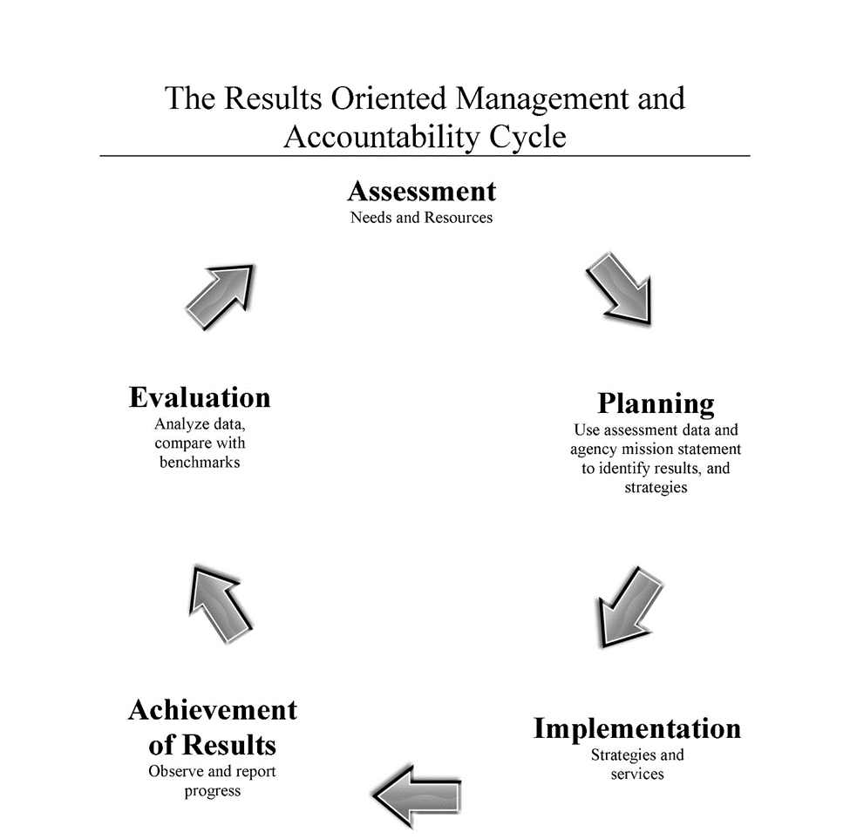
Observing Results and Evaluation in the ROMA Cycle
Colorado Community
Action Association

Slide 48
Outcome Indicators
Outcome Indicator for our Family Level Logic Model
Be sure to include:
Number expected to achieve the outcome (n)
Number expected to be served (d)
A clearly worded outcome statement that puts the numbers in context.
The time frame for the expected performance.
This projection is not expected to be 100% accurate. Any projections that fall within a range of 80-120% targeting accuracy require no formal comment during reporting.
Approach 100% projections targeting when services provided to population is proven to produce certain levels of customer success.
MATERIAL FROM INTRO TO ROMA 5.1, 2020
Colorado Community
Action Association
Notes:
PM 99 K152-154,
start to create an outcome indicator for the outcome we have identified in the family level logic model we are building.
(note: we do not add percent at this time.. We add it in the next section.)
Bring up the word document with the logic model you are building and
First go back to column 2 (the service column) and add two data elements: the number of participants expected to be served and the time frame.
Then create an appropriate statement in the OI column.
DO NOT PUT IN PERCENT AT THIS TIME.

Slide 49
ACTIVITY
Breakout Groups:
Outcome Indicator for our Family Level Logic Model
Be sure to include:
Number expected to achieve the outcome (n)
Number expected to be served (d)
A clearly worded outcome statement that puts the numbers in context.
The time frame for the expected performance.
MATERIAL FROM INTRO TO ROMA 5.1, 2020
Colorado Community
Action Association
Notes:
PM 99 K152-154,
start to create an outcome indicator for the outcome we have identified in the family level logic model we are building.
(note: we do not add percent at this time.. We add it in the next section.)
Bring up the word document with the logic model you are building and
First go back to column 2 (the service column) and add two data elements: the number of participants expected to be served and the time frame.
Then create an appropriate statement in the OI column.
DO NOT PUT IN PERCENT AT THIS TIME.

Slide 50
Establishing Measurement Tools
Measurement tools are the documents that will prove your outputs and outcomes.
MATERIAL FROM INTRO TO ROMA 5.1, 2020
Colorado Community
Action Association
Notes:
PM-116 TM 113 K179
When considering the outcomes you expect to achieve, you have to consider how you will measure the accomplishment of those outcomes.
Measurement tools must be able to capture data for each program or service - quantifying both the outputs and the outcomes.
Remember in earlier sections we talked about how a report card would be an appropriate measurement tool to ‘prove’ an outcome of improved grades.

Slide 51
Establishing Measurement Tools
Output measurement tools
Outcome measurement tools
These tools document the services and processes provided by the agency or activities done by the customer.
These tools document the change that has happened.
MATERIAL FROM INTRO TO ROMA 5.1, 2020
Colorado Community
Action Association
Notes:
PM-116 TM 113 K179
Review types of OutPut Measurement tools
Review types of OutCome Measurement tools

Slide 52
Identifying Data Procedures and Frequency
PROCESSES
TOOLS
MATERIAL FROM INTRO TO ROMA 5.1, 2020
Colorado Community
Action Association
Notes:
PM-120 TM 115-117 K183-185
If you stop building the logic model with the statement of the indicator without identifying how you will measure (the tool that is proof, the process for collecting data, the frequency of collection) then the focus on the outcome may not be clearly identified or produced. That means it might get no attention.
Pull up the logic model we have been building so that we can refer to the elements of our logic model we have already created.
walk us through our final steps
Let’s now identify some tools to measure our outcome indicator and will also identify data collection processes.
These last three columns are details that make the emphasis on documenting your results more explicit.
Mention the qualitative or quantitative measurement concept.
BE SURE THEY ARE IDENTIFYING MEASURES OF THE INDICATOR that they have developed.

Slide 53
Family Level Measurement Tools and Process
Measurement Tools | Data Source | Frequency
Output: | Who: | Data collection:
 | How:
Outcome: | Where: | Reporting:
Virtual Logic Model
MATERIAL FROM INTRO TO ROMA 5.1, 2020
Colorado Community
Action Association
Notes:
PM 141 TM 132-133 K212
The Does It Match activity is very important, because it allows the Trainer to assess the level of learning/understanding participants have about the elements of the logic model.
Note: You can have participants turn to the Logic Model check list PM-145 to evaluate the elements – are they correctly included?
More importantly, this reinforces the idea that the elements must match. If every cell is correct on its own, but doesn’t match, then the LM is flawed.
Note column 5 is intentionally skipped – this is the LM in the planning stage.
You can read the Need, Service and Outcome columns and say we are going to consider if these match and also the completeness of the information.
The next slide has animation to help you talk through the elements.

Slide 54
ACTIVITY
Breakout Groups:
Organization/Small group ROMA Logic Model Columns 6-8
Handout
Large Group:
Group ROMA Logic Model Columns 6-8
Colorado Community
Action Association
Colorado Community
Action Association

Slide 55
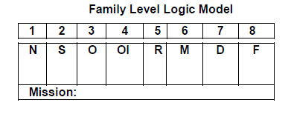
Does the Information Match?
Column 1 Need | Column 2 Service or Activity | Column 3 Outcome | Column 4 Outcome/Indicator | Column 6 Measurement Tool | Column 7 Data Source, Data Collection Procedures, Personnel | Column 8 Frequency of Data Collection and Reporting
Individuals have limited financial literacy skills. | Individuals receive advanced financial counseling. | Individuals increase their financial position in order to qualify for home mortgages | 7/20 or 35% of Individuals will increase their credit score by 10% or more. | Attendance at counseling sessions; record of home mortgage | Case record | At time of counseling attendance.
MATERIAL FROM INTRO TO ROMA 5.1, 2020
Colorado Community
Action Association
Notes:
PM 141 TM 132-133 K212
The Does It Match activity is very important, because it allows the Trainer to assess the level of learning/understanding participants have about the elements of the logic model.
Note: You can have participants turn to the Logic Model check list PM-145 to evaluate the elements – are they correctly included?
More importantly, this reinforces the idea that the elements must match. If every cell is correct on its own, but doesn’t match, then the LM is flawed.
Note column 5 is intentionally skipped – this is the LM in the planning stage.
You can read the Need, Service and Outcome columns and say we are going to consider if these match and also the completeness of the information.
The next slide has animation to help you talk through the elements.

Slide 56
Does the Information Match?
Column 1 Need | Column 2 Service or Activity | Column 3 Outcome | Column 4 Outcome/Indicator | Column 6 Measurement Tool | Column 7 Data Source, Data Collection Procedures, Personnel | Column 8 Frequency of Data Collection and Reporting
Individuals have limited financial literacy skills.
Individuals receive advanced financial counseling.
Individuals increase their financial position in order to qualify for home mortgages
7/20 or 35% of individuals will increase their credit score by 10% or more.
Attendance at counseling sessions; record of home mortgage
At time of counseling
Case Record
Data collected at time of each counseling session. Post test done at last session.
Data reported weekly to supervisor, quarterly to admin and board, annually to funding source.
Case Manager meets with individuals in office; enters data into case record and data base.
20 Individuals receive financial counseling within the program year.
7/20 or 35% of individuals will increase their financial literacy skills within the program year.
Intake forms; Log of attendance at counseling sessions (OP); pre/post test of financial literacy skills (OC)
Individuals increase financial literacy skills.
MATERIAL FROM INTRO TO ROMA 5.1, 2020
Colorado Community
Action Association
Notes:
Trainer 1PM-141....TM-132-133 K212
This slide can help you talk through this example.
Start with the need statement and ask if it is a clearly stated family level need. (it is ok) Sometimes people want to say it isn’t clear what kind of skills… but you can just say that
Then ask participants to compare the need statement with the outcome statement in column 3. (they do not match)
Go back to column 2 and see if it matches the need and outcome. Note the difference between “limited skills” in column 1 and “advanced counseling” in column 2.
Additionally there is no number to be served in column 2 and no time frame.
Statement in column 4 does not match the need. Nor does it appear to be clear match with the stated outcome. It seems to be introducing an additional element (credit score)
No time frame in column 4.
Column 6 - Both outcome and output measurement tools are included – but the outcome measurement tool (record of home mortgage) does not match either the need nor the outcome (as stated).
Column 7 – no procedure or personnel are included.
Column 8 – if data is only collected at time of counseling session, you may not know if any change has happened. When would reporting happen?

Slide 57
ACTIVITY
Large Group:
Do they match?
Organization/Small group ROMA Logic Model Examples
Colorado Community
Action Association
Colorado Community
Action Association

Slide 58
ROMA Logic Model 1.0 – Emergency Housing Example
National ROMA Peer-To-Peer Training Program
Organization: CAA Program: Emergency Housing ☑ Family Level
Need | Service or Activity | Outcome | Projected Indicator | Actual Indicator | Measurement Tool | Data Procedures | Frequency
(1) Planning | (2) Intervention | (3) Benefit | (4) Performance | (5) Performance | (6) Accountability | (7) Accountability | (8) Accountability
 | 200 families will receive housing assistance, during fiscal year July 1 to June 30 |  |  | 203 families actually received housing assistance, July 1, - June 30
Families are at risk of being evicted. | One month emergency rent payment will be issued for 150 families within the program yea. | Families remain in their own residence. | 150 of 150, or 100%, of families will remain in their own residence for 30 days. | 142 of 155, or 92%, of families remain in their own residence 30 days. 132 of 155, or 85%, of families remain in their own residence 60 days. 90 of 155, or 58%, of families remain in their own residence 90 days | Housing application Housing activity log showing payments. Record of paying rent Family report during follow up. Copies of current payments. | Case record. Data entered into automated case record at time of encounter. Data entered by CAA case-manager. | Data collected at time of encounter. Summary report generated to supervisor daily. Weekly report generated to department head each Monday. Monthly report generated for executive director.
Families are homeless. | Up to 30 days of emergency shelter services will be provided for 50 families within the program year. | Homeless families reside in safe temporary shelter. | 50 of 50, or 100%, of homeless families will reside in safe shelter for up to 30 days. | 48 of 48, or 100%, of homeless families resided in safe shelter for 7 to 30 days. | Shelter log. Family report during follow up. | Case Record. Data entered into case record at time of encounter. Data entered by shelter case-manager. | Data collected at time of encounter. Daily electronic report emailed to CAA at daily close of business.
Mission: To ensure that all families have safe, clean shelter.
Colorado Community
Action Association
56
Notes:
PM 146-147 TM 135-137 K219-222
Logic Model 1.0
Emphasize the concept of using the LM for data analysis -- to support assessing client outcomes and program effectiveness.
The Logic Model is a way to display and analyze data, that can lead to changes in programs if indicated by the data.
In Column 1 “Need” which is the Planning column, there are two needs: families are at risk of being evicted and families are homeless.
Column 3 “Outcome” - there are two outcomes or benefits: families remain in their own residence and homeless families obtain emergency shelter.
Column 2, “Service or Activity” -- two interventions offered by the agency: one month emergency rent payment and emergency shelter.
Note that it is expected that 200 families will receive services (projection) during the program year. Remind folks that this is Carter question #1 (how many will you serve) and the denominator of the performance formula that is in Column 4.
Go to Column 4 “Outcome/Indicator” and state that these are the projections of outcomes that will be achieved by the clients. These numbers are the numerator of the projected performance formula.
THE FOCUS OF YOUR PRESENTATION IS COLUMN 5 WHICH INDICATES THE ACTUAL RESULTS.
IT IS THE ANALYSIS OF THESE RESULTS WHICH IS THE MESSAGE WHICH IS ALSO IN THE BOX ON PAGE 148 OF THE PARTICIPANT MANUAL.
There are two key points here:
1. The agency followed-up the client after the service was delivered, and
2. The agency collected and analyzed the follow-up data to determine the effectiveness of the service.
The question that was asked is, “Did the intervention have the desired results?”
This agency found that the emergency shelter service actual results appeared to be close to the projections.
But the rental assistance intervention/service was less effective than originally expected.
What the agency learned was that the longer the time period following the service/intervention, the greater the likelihood of a family losing their housing.
The service produced a 92% outcome in the first 30 days. This was close to the projection at this point in time (30 days post service).
Follow-up data at 60 days reveals that not all of those who achieved a 30 day stability were able to maintain it; 85% remain in their homes after 60 days.
At 90 days, families increasingly lose their housing; 58% remain in their homes after 90 days.

Slide 59
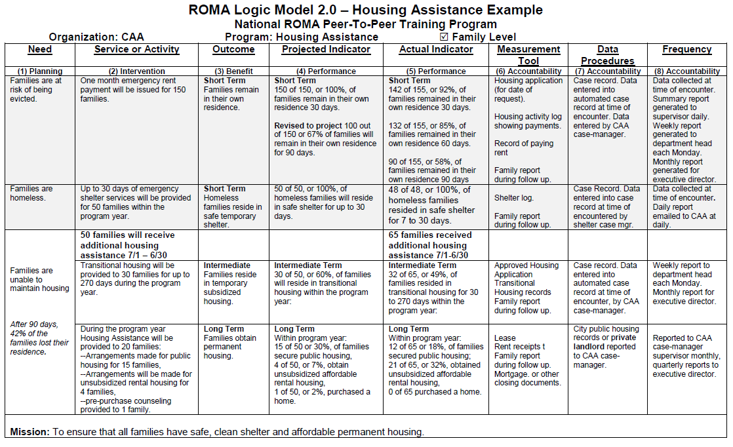
MATERIAL FROM INTRO TO ROMA 5.1, 2020
Colorado Community
Action Association
Notes:
PM 146-147 TM 135-137 K219-222
Logic Model 1.0
Emphasize the concept of using the LM for data analysis -- to support assessing client outcomes and program effectiveness.
The Logic Model is a way to display and analyze data, that can lead to changes in programs if indicated by the data.
In Column 1 “Need” which is the Planning column, there are two needs: families are at risk of being evicted and families are homeless.
Column 3 “Outcome” - there are two outcomes or benefits: families remain in their own residence and homeless families obtain emergency shelter.
Column 2, “Service or Activity” -- two interventions offered by the agency: one month emergency rent payment and emergency shelter.
Note that it is expected that 200 families will receive services (projection) during the program year. Remind folks that this is Carter question #1 (how many will you serve) and the denominator of the performance formula that is in Column 4.
Go to Column 4 “Outcome/Indicator” and state that these are the projections of outcomes that will be achieved by the clients. These numbers are the numerator of the projected performance formula.
THE FOCUS OF YOUR PRESENTATION IS COLUMN 5 WHICH INDICATES THE ACTUAL RESULTS.
IT IS THE ANALYSIS OF THESE RESULTS WHICH IS THE MESSAGE WHICH IS ALSO IN THE BOX ON PAGE 148 OF THE PARTICPANT MANUAL.
There are two key points here:
1. The agency followed-up the client after the service was delivered, and
2. The agency collected and analyzed the follow-up data to determine the effectiveness of the service.
The question that was asked is, “Did the intervention have the desired results?”
This agency found that the emergency shelter service actual results appeared to be close to the projections.
But the rental assistance intervention/service was less effective than originally expected.
What the agency learned was that the longer the time period following the service/intervention, the greater the likelihood of a family losing their housing.
The service produced a 92% outcome in the first 30 days. This was close to the projection at this point in time (30 days post service).
Follow-up data at 60 days reveals that not all of those who achieved a 30 day stability were able to maintain it; 85% remain in their homes after 60 days.
At 90 days, families increasingly lose their housing; 58% remain in their homes after 90 days.

Slide 60
Answering Carter’s 7 Key Questions
How many clients are you serving?
Who are they?
What services do you give them?
What does it cost?
What does it cost per service delivered?
What happens to the clients as a result of the service?
What does it cost per outcome?
100
Single unemployed women, ages 21-34 that are seeking employment
and have at least one child under the age of 12.
A package of job readiness training, job placement
and 90 day follow-up services after job placement.
$100,000 for the total program
$100,000/100 = $1,000/job readiness/training/placement package or $1,000/client.
10 clients or 10% of the program
participants will obtain a full time job above minimum wage with employer provided benefits.
$100,000/10 clients = $10,000/outcome.
This means that the successful outcome (a full time job above minimum wage with employer provided benefits) cost $10,000 to produce.
Colorado Community
Action Association

Slide 61
ACTIVITY
Breakout Groups:
What are some potential difficulties of conducting a Cost-Benefit Analysis? Organization/Small Group
Large Group:
Recap Cost-Benefit Analysis Discussions
Colorado Community
Action Association
Colorado Community
Action Association

Slide 62
Board/Stakeholders Input/Acceptance
Action Plans and Strategic Plans are living document
Action Plans and Strategic Plans have a life-cycle (3-years for Community Action Plan)
Board acceptance and buy-in is crucial
Plans should be publicized
Update Board annually on the successes of the plans
MATERIAL FROM INTRO TO ROMA 5.1, 2020
Colorado Community
Action Association

Slide 63
Social Return on Investment (SROI)
Overview
The relationship of interventions and services to costs and outcomes is important to establish.
Distinguish between the cost for delivering services and the cost to produce an outcome.
Results we are able to achieve may be limited by available resources. Resources often determine the quantity and type of services provided.
Calculating a Benefit-Cost and Return-On-Investment (ROI) analysis can provide a basis to argue for more resources.
ROMA Module 8 – SROI Example
(National ROMA Peer-To-Peer-Training Program, Participant Manual, “Introduction to ROMA” Version 4.3, © 2011. F.
Richmond and B. Mooney, The Center for Applied Management Practices, Camp Hill, PA 717-730-3705)
Colorado Community
Action Association

Slide 64
SROI Calculation Uses & Purposes
Uses:
Justify program through impact
Asset for seeking funding
Better understand all inputs and outcomes of programs
Purposes:
When profit isn’t the outcome, how is the outcome valued?
Nonprofits impact – variety of outcomes
We are always being asked to show our impact and accomplish more with less
Colorado Community
Action Association

Slide 65
SROI Calculation Limitations
Not appropriate for some programs
The outcomes exist, but they are hard to quantify
Measure things that don’t happen (avoided hospital stay)
Colorado Community
Action Association

Slide 66
Calculating Social Return on Investment:
Using the Carter-Richmond Methodology
How many clients are you serving?
Who are they?
What services do you give them?
What does it cost?
What does it cost per service delivered?
What happens to the clients as a result of the service?
What does it cost per outcome?
100
Single unemployed women, ages 21-34 that are seeking employment
and have at least one child under the age of 12.
A package of job readiness training, job placement
and 90 day follow-up services after job placement.
$100,000 for the total program
$100,000/100 = $1,000/job readiness/training/placement package or $1,000/client.
10 clients or 10% of the program
participants will obtain a full time job above minimum wage with employer provided benefits.
$100,000/10 clients = $10,000/outcome.
This means that the successful outcome (a full time job above minimum wage with employer provided benefits) cost $10,000 to produce.
Colorado Community
Action Association

Slide 67
Calculating Social Return on Investment:
Using the Carter-Richmond Methodology
8. What is the value of a successful outcome?
The value of the outcome is:
$20,000 Income from employment
$5,000 Benefits from employer
$3,000 EITC
$200 Payment of taxes
$10,000 Elimination of welfare and other subsidized benefits
Total = $38,200 per year
9. What is the return on investment?
ROI Individual:
Value of Outcome Cost of Outcome or 38,200/10,000 = 382% return
ROI Program:
Value of Outcomes ($38,200) x (10) participants = $382,000 (RETURN)
Cost of Outcomes ($10,000) x (10) participants = $100,000 (COST)
The cost of the program at $100,000 returned $382,000 in benefits.
Every $1.00 invested in the program returned $3.82 in benefits.
Colorado Community
Action Association

Slide 68
Calculating SROI - Proceed with Caution
Build and maintain buy-in from stakeholders
Use existing research
Be conservative!
Explain in detail
Use local data and knowledge when possible
Only use what you can quantify and justify
Be sure to calculate the value, both positive and negative, of all the outcomes that are obtained through a program/service.
Colorado Community
Action Association

Slide 69
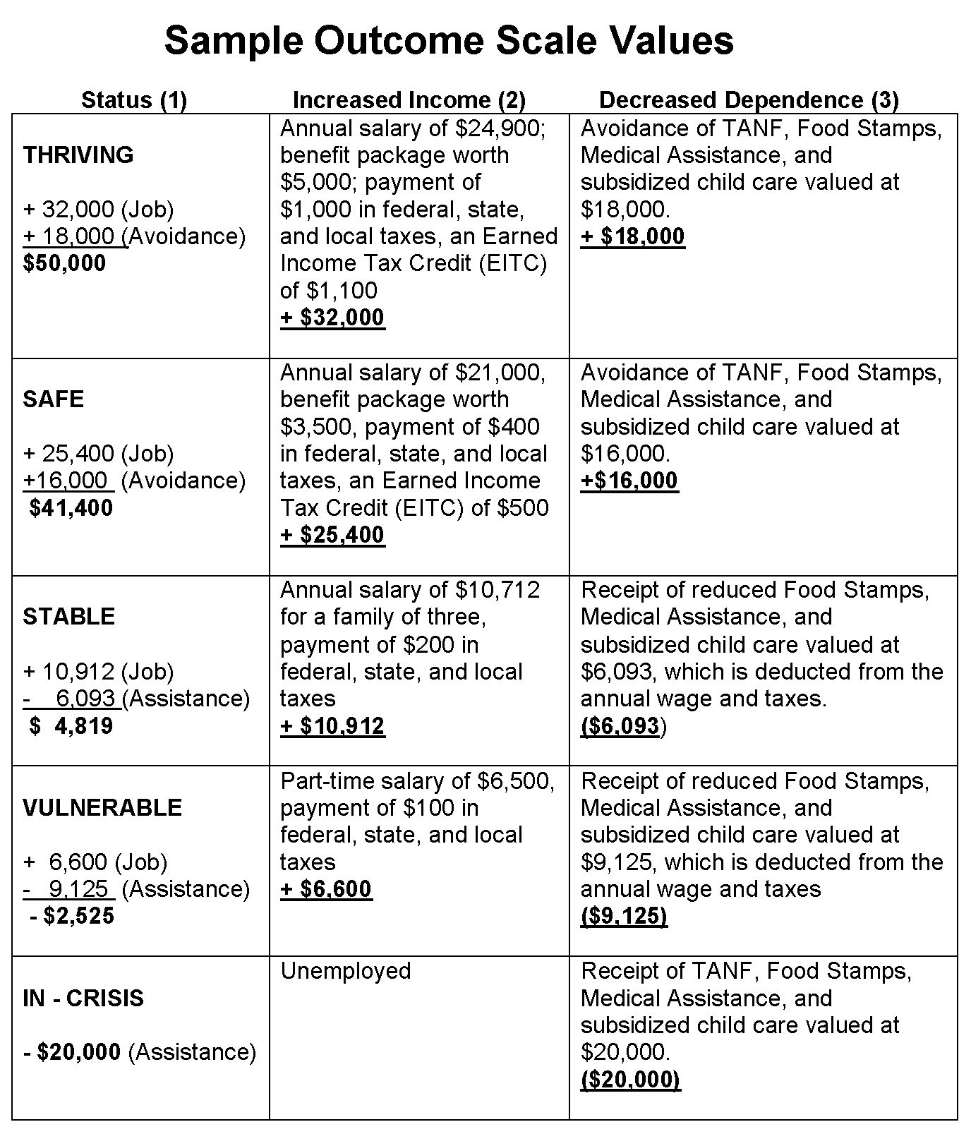
Sample Outcome Scale Values
(National ROMA Peer-To-Peer-Training Program, Participant Manual, “Introduction to ROMA” Version 4.3, © 2011. F.
Richmond and B. Mooney, The Center for Applied Management Practices, Camp Hill, PA 717-730-3705)
Colorado Community
Action Association

Slide 70
1) The IRS could recover $12 for every $1 spent on scrutinizing the ultra-wealthy's taxes: A new study by economists finds that the IRS could recover $12 for every $1 spent on auditing the top 10% of taxpayers. The study, which was published in the journal Tax Policy Center, found that auditing the wealthy is a highly effective way to collect taxes. For example, the study found that auditing the top 1% of earners could yield $120 billion in revenue. 2) New Report: Every Dollar Invested in U.S. School Meal Programs Provides $2 in Health and Economic Equity Benefits: A new report by The Rockefeller Foundation and the Center for Good Food Purchasing finds that every dollar invested in U.S. school meal programs provides more than $2 in benefits to society. The report, titled "True Cost of Food: School Meals Case Study," found that school meal programs generate nearly $40 billion in human health and economic benefits annually
SROI Examples
Colorado Community
Action Association

Slide 71
ACTIVITY
Large Group Discussion:
What Services/Strategies might lend well to SROI calculation?
Colorado Community
Action Association
Colorado Community
Action Association

Slide 72
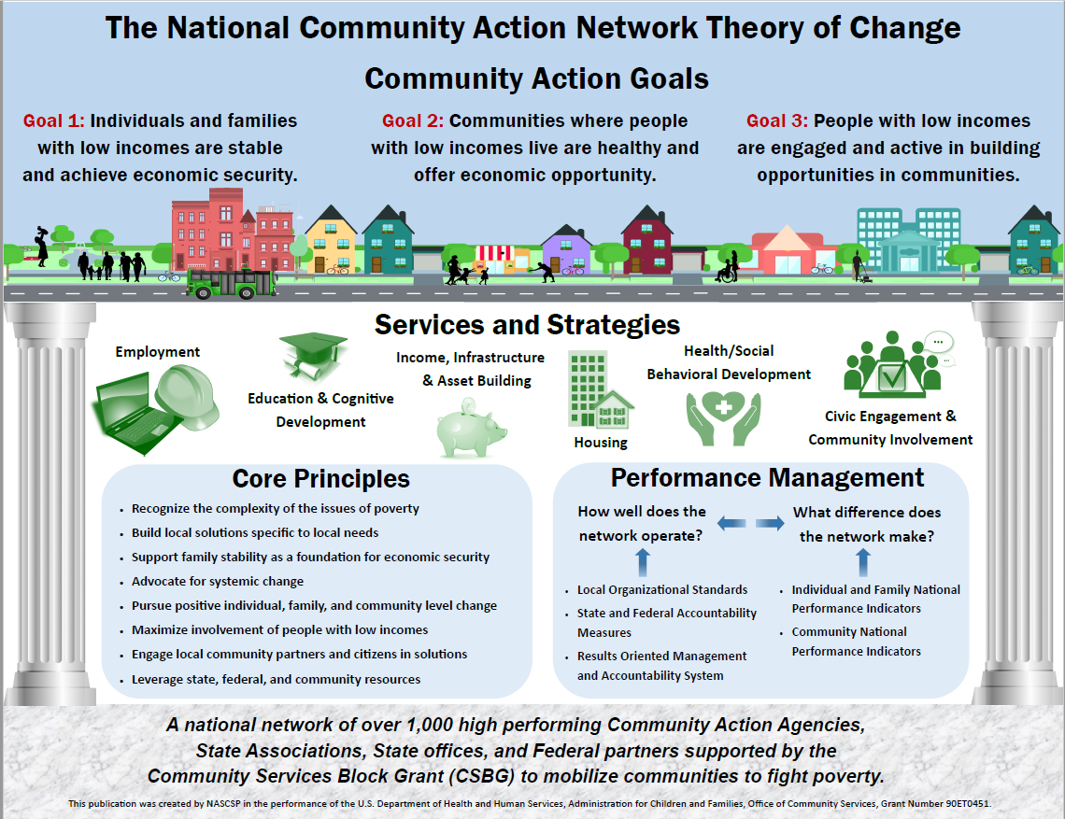
Colorado Community
Action Association

Slide 73
Need for a Local Theory of Change
As a network, we do not have a unified, standardized understanding of the changes that we expect to achieve.
The National Goals were designed to provide a framework for our work.
However, they are not universally used by agencies to guide the planning, implementation and analysis phases of ROMA.
And they are not actually measured.
Large Group Discussion: What would it take for an average customer to not need the services of your agency?
Colorado Community
Action Association
Notes:
We need to be able to explain what we do, why we do it, how effective we are…. Road map to external public.
This is on a national level, but can be used locally… what does change look like? Just having “a job” might not provide enough income to be self-sufficient

Slide 74
How will the Theory of Change help?
The TOC will help us describe the elements of a common process agencies are engaged in to PRODUCE CHANGE
Identify the ASSUMPTIONS that guide the design of services and strategies to reach the LONG-TERM GOALS it hopes to achieve.
Helps explain the RELATIONSHIP between the identified community needs and the strategies selected to achieve the long term goals.
Shows the CONNECTIONS between activities and outcomes.
Large Group Discussion: What assumptions are inherent in your agency’s services, outcomes, and/or goals?
Colorado Community
Action Association
Notes:
This is like a logic model, but it includes assumptions and should explain the relationships and connections between data, strategies, and outcomes.

Slide 75
Use what you know about your organizational culture to apply to the local TOC
Think about how “we have always done” the work of the agency
What is real, what is true, what is good, what is done?
Think about the outcomes (changes) that you have achieved in the past.
Think about WHAT ELSE your agency could achieve if you were not “problem” focused
The ideas that are generated by this kind of thinking will influence your creation of your local Theory of Change.
Every agency has a Theory of Change, explicit and written-down, or implicit and commonly known.
Large Group Discussion: Has your agency’s Theory of Change primarily addressed the conditions of poverty or the causes of poverty?
And, why?
Colorado Community
Action Association

Slide 76
Big Thinking
Which needs require community level strategies and/or partnerships?
What can you do to contribute to impacting those needs that are not the immediate mission of your agency?
Large Group Discussion: How does our agency partner in the community?
Colorado Community
Action Association

Slide 77
Differing (but complimentary?) Approaches
There are two differing approaches to take to achieve progress toward movement out of poverty:
Agency must provide emergency services to help stabilize families who are in crisis before they can be able to consider what to do to move out of poverty.
Agency should find other community partners to provide emergency services so they can focus on providing a full range of services that support people as they move out of poverty.
Large Group Discussion: How does your agency’s service delivery model (strategic thinking vs provision of service) affect outcomes?
Colorado Community
Action Association
Notes:
Some members of the National Community Action Network believe that the local Community Action Agency must provide emergency services to help stabilize families who are in crisis before they can be able to consider what to do to move out of poverty.
Other members believe the provision of emergency services is to be left to other community partners and that the Community Action Agency’s role is to find those partners so that the Community Action Agency can focus on providing a full range of services to support families moving out of poverty.
The decision to either provide emergency services or not provide emergency services is based on a belief about the role of the agency in anti-poverty work in the community.

Slide 78
Consider the individuals and families
Are they coming to the agency because of an emergency? Because they are facing a crisis of some kind?
Do you provide immediate tangible assistance?
What kind of “result” do you see?
Does the assistance help the family move out of the crisis state?
Is there a change in status?
Is the situation temporarily addressed, but the crisis persists?
Large Group Discussion: What do families need versus what do families get from your agency when they visit?
Colorado Community
Action Association

Slide 79
Assumptions behind services
Prevention services – we believe that the tangible assistance given to the customer will prevent a crisis.
Rent payment will avoid an eviction and keep families in their home.
Stabilization services – we believe that the tangible assistance will enable the family to maintain all their basic needs
Monthly food distribution allows the family to stretch other resources to enable all basic needs to be met
Gateway services – we believe that the tangible assistance will enable us to establish a relationship with the family, and they will return to the agency for other services.
Food pantry recipient will ask about training opportunities or other tangible assistance needed.
Large Group Discussion: How do you measure long-term success around families served?
Colorado Community
Action Association

Slide 80
What relationships are important to support the agency’s goals?
The bus runs in an area that needs transportation for employment.
Describe the change
How will you know?
What will you Measure?
What NPI’s will you use to report?
X neighborhood has regular public transportation access in areas and at times that are needed to get to employment.
Connect your outcomes to long-term goals to be achieved.
Community has appropriate, reliable, accessible, affordable, and safe public transportation.
We (the agency) know what routes and times are needed.
What is the agency supposed to do about poverty in the community?
Route Study
DEIB Informed Outreach
Individuals will ride the bus to their employment.
What does the agency believe about poverty?
Community Activities
Employer/Employee Incentives
Bus routes/times will not deviate from standard procedures (only major roads can be routes and only 7am-9pm service)
Colorado Community
Action Association

Slide 81
HEALTHY COMMUNITY
The bus runs in an area that needs transportation for employment.
Employer Engagement
The bus runs in an area that needs transportation for employment.
X neighborhood has regular public transportation access in areas and at times that are needed to get to employment.
Employee/Neighborhood Engagement
X neighborhood has regular public transportation access in areas and at times that are needed to get to employment.
Community has appropriate, reliable, accessible, affordable, and safe public transportation.
Community has appropriate, reliable, accessible, affordable, and safe public transportation.
We (the agency) know what routes and times are needed.
We (the agency) know what routes and times are needed.
Route Study
Route Study
DEIB Informed Outreach
Individuals will ride the bus to their employment.
Individuals will ride the bus to their employment.
DEIB Informed Outreach
Community Activities
Community Activities
Bus routes/times will not deviate from standard procedures (only major roads can be routes and only 7am-9pm service)
Employer/Employee Incentives
Bus routes/times will not deviate from standard procedures (only major roads can be routes and only 7am-9pm service)
Employer/Employee Incentives
Final Mile & After-Hours Strategy
Colorado Community
Action Association

Slide 82
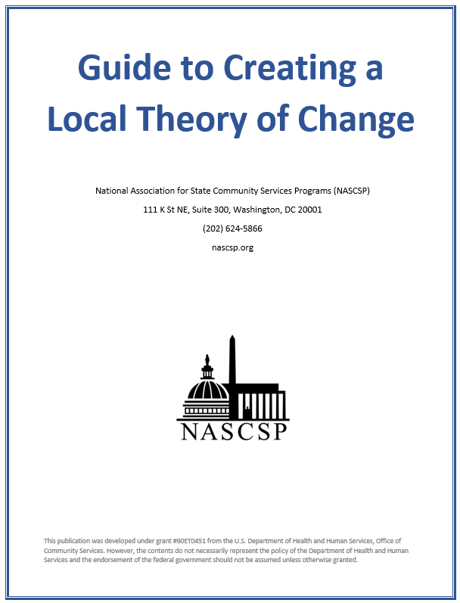
Guide to Creating a Local Theory of Change
Colorado Community
Action Association
Notes:
The National Association for State Community Services Programs, or NASCSP, has created a tool kit for local agencies to use to create their Theory of Change. You can access the toolkit WHERE.
Additionally, the Community Action Partnership has created a curriculum for a half-day in person training and work-session to support your efforts and work through the sections of the toolkit. You can find out more about the training WHERE.

Slide 83
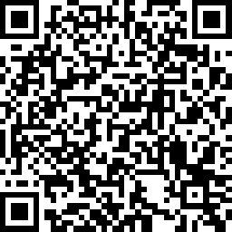
Next Steps and Evaluations
AND GROUP PICTURE
Next Steps:
Technical assistance
Logic models review
Theory of Change training for communities
SROI calculations
ROMA Certified Trainers reviews
Evaluation
Please take a few minutes to provide us with valuable feedback by using your smartphone camera to take the Regional Forum Evaluation. We use this feedback to improve future gatherings and trainings.
THANK YOU!
Regional Forum Evaluation can be completed at:
https://www.surveymonkey.com/r/VD78XB3
Colorado Community
Action Association

Slide 84
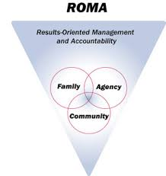
Upcoming Training Opportunities
Regional Forums
Limon – June 15, 2023
Durango – June 22, 2023
Pueblo – July 6, 2023
Lamar – July 11, 2023
Westminster – July 13, 2023
Frisco – July 20, 2023
Grand Junction – July 26, 2023
Craig – July 27, 2023
Fort Morgan – August 3, 2023
Castle Rock — August 16, 2023
Virtual – September 7, 2023
ROMA
Is your community interested in attending a ROMA training? Let us know!!!
Visit https://www.coloradocommunityaction.org/roma.html and submit the contact form and we will be in touch to schedule a ROMA Training in your community!
There are also Virtual ROMA training sessions you can sign up for (three 3-hour sessions on Wednesday mornings)
August 2, 9, 16 (9am-12noon)
October 11, 18, 25 (9am-12noon)
Colorado Community
Action Association

Slide 85
CO Department of Local Affairs (DOLA) www.dlg.colorado.gov/community-services-block-grant-csbg Alex Diaz (They/she) Program Manager 303-864-8423 Alex.Diaz@state.co.us Audrey Field (She/her) Financial Assistance Manager 303-864-7897 Audrey.Field@state.co.us Becky Saad (She/ her) Program Coordinator 303-864-7894 Becky.Saad@state.co.us | Colorado Community Action Association www.coloradocommunityaction.org Josiah Masingale (he/him) 303-949-9934 ext 801 josiah@coloradocommunityaction.org Liz Espinoza (she/her) 303-949-9934 ext 803 liz@coloradocommunityaction.org Jessica Roschen (she/her) 303-949-9934 ext 804 jessica@coloradocommunityaction.org Steven Panchenko (he/him) steven@coloradocommunityaction.org
Colorado Community
Action Association
Notes:
Thank you and moving forward.
Requesting specific T/TA through DOLA/CCAA.

Slide 86
ACTIVITY
Breakout Groups:
Theory of Change Handout
Goals/outcomes
Assumptions
Strategies to address assumptions
Large Group Discussion:
Theory of Change realizations
Colorado Community
Action Association
Colorado Community
Action Association

Slide 87
Colorado Community
Action Association

